Slide 1


CITS1003 Introduction to Cybersecurity [B] Cyber Law and CI & CPS exercises
Dr Zhi Zhang

Slide 2
Privacy preserving
Secure Multi-Party Computation (SMPC)
Homomorphic Encryption (HE)
Differential Privacy (DP)
Software-induced hardware vulnerability: Rowhammer
Rowhammer against DP

Slide 3
What is privacy
Privacy refers to the ability of individuals to control the access and use of their personal information (e.g., name, phone number, etc).

Slide 4
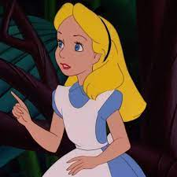

What is Privacy
provides personal information
to sign up for a membership
Alice
Why does Costco collect users’ private data?

Slide 5
What is Privacy
Model Training
provide users’ data
Well-trained
Model
e.g., her favourite items

Slide 6
What is Privacy Preserving
provide anonymized
users’ data
Model Training

Slide 7
What is Privacy Preserving
Privacy preserving
protects data from being disclosed to unauthorized parties
enables the collection and analysis of data

Slide 8
What is Privacy Preserving
Privacy preserving
protect data from being disclosed to unauthorized parties
enable the collection, and analysis of data
How to collect and analyze data without leaking private information?

Slide 9
Privacy Preserving
Privacy preserving
protect data from being disclosed to unauthorized parties
enable the collection, and analysis of data
How to collect and analyze data without leaking private information?
Data anonymization: hide personal identifiers that may lead to an individual being identified
e.g., data masking: remove personally identifiable data such as user names and credit card details.

Slide 10
Privacy Preserving
Data anonymisation: removing personal identifiers that may lead to an individual being identified
Data anonymisation is NOT secure enough
e.g., data linking attack: correlates anonymized data with publicly available data sources to re-identify individuals.

Slide 11

What is Privacy Preserving
A Hospital
A Third-party
Data Analytics Company
Raw Medical Records
(e.g., patients’ names, gender, age, addresses and postcode)
Data Anonymization
Anonymized Medical Records
(e.g., names and addresses are masked,
while gender, age and postcode are kept)
A Third-party
Data Analytics Company

Slide 12
What is Privacy Preserving
A Hospital
A Third-party
Data Analytics Company
Raw Medical Records
(e.g., patients’ names, gender, age, addresses and postcode)
Public Data
(e.g., voting records and social media profiles)
Data Anonymization
Patient Re-identification
Anonymized Medical Records
(e.g., names and addresses are masked,
while gender, age and postcode are kept)
A Third-party
Data Analytics Company

Slide 13
Privacy Preserving
Data anonymisation: removing personal identifiers that may lead to an individual being identified
Data anonymisation is NOT secure enough
Secure multi-party computation
Homomorphic encryption
Differential privacy

Slide 14
Secure Multi-party Computation
Secure multi-party computation is a privacy concept that distributes a computation across multiple users where no user can see the other users' data.

Slide 15
Secure Multi-party Computation
Secure multi-party computation is a privacy concept that distributes a computation across multiple users where no user can see the other users' data.
e.g., Additive secret sharing
Additive Secret Sharing refers to the division of a secret and its distribution among a group of independent participants.

Slide 16

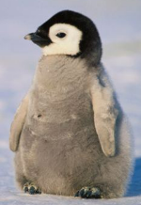
Secure Multi-party Computation
Situation: Three coworkers--Alice, Emu and Penguin—want to compute their average hourly rate
Requirement: They do not want to reveal their own rate to each other or a third-party.
Alice (A)
$50
Emu (E)
$120
Penguin (P)
$180
https://stock.adobe.com/search?k=emu+cartoon

Slide 17
Secure Multi-party Computation
Steps:
1. Each staff split their rate randomly into n (n=3) secret shares
A: $50
E: $120
P: $180

Slide 18
Secure Multi-party Computation
Steps:
1. Each staff split their rate randomly into 3 secret shares
A: $50 -> $10, $5, $35
E: $120 -> $25, $100, -$5
P: $180 -> $10, $100, $70
2. Each staff keeps one secret share and distributes the remaining two secret shares to the other two staffs.

Slide 19
Secure Multi-party Computation
After secret sharing is completed:
A | E | P
5 | 35 | 10
100 | 25 | -5
70 | 10 | 100
A = 50
E = 120
P = 180

Slide 20
Secure Multi-party Computation
After secret sharing is completed:
A
5
100
70
A = 50
E = 120
P = 180

Slide 21
Secure Multi-party Computation
After secret sharing is completed:
 | E
 | 35
 | 25
 | 10
A = 50
E = 120
P = 180

Slide 22
Secure Multi-party Computation
After secret sharing is completed:
 |  | P
 |  | 10
 |  | -5
 |  | 100
A = 50
E = 120
P = 180

Slide 23
Secure Multi-party Computation
After secret sharing is completed:
A | E | P
5 | 35 | 10
100 | 25 | -5
70 | 10 | 100
175 | 70 | 105
A = 50
Sum: 350
E = 120
P = 180
Sum: 350
Average: 350/3 = 116.67

Slide 24
Secure Multi-party Computation
What is the main limitation of SMPC in practice?

Slide 25
Secure Multi-party Computation
What is the main limitation of SMPC in practice?
e.g., computational overhead and communication cost

Slide 26
Secure Multi-party Computation
What if one coworker is dishonest and distributes false secret shares?
e.g., Zero Knowledge Proof
Zero Knowledge Proof is a cryptographic protocol by which one party (a prover) can prove to another party (a verifier) that something is true, without revealing any information apart from the fact that this specific statement is true.

Slide 27
Zero Knowledge Proof
Situation: Alice and Bob want to find a friend called Wally in a given image. Alice has knowledge of where Wally is in the image, but Bob doesn’t believe Alice.
How does Alice prove to Bob that she knows where Wally is without giving away Wally’s location in the image?

Slide 28
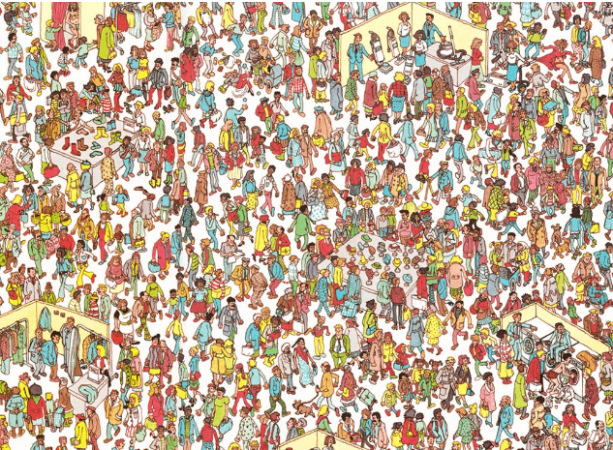

Slide 30
Zero Knowledge Proof
Situation: Bob meets Alice that he does not know, yet Alice claims to be a member of a group that Bob is also a part of.
How can Bob know if he can trust her? Assume the group has a locked safe, and only the group members know the secret pin code and open the safe.
e.g., sharing their pin code with a trusted third party.

Slide 31
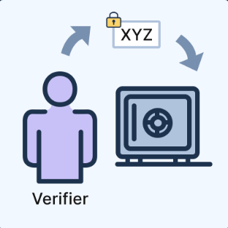
Zero Knowledge Proof
Steps:
1. The verifier Bob writes a secret message and puts it in the locked safe

Slide 32
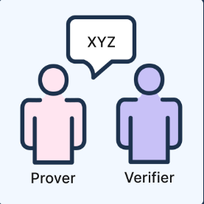
Zero Knowledge Proof
Steps:
2. The prover Alice has knowledge of the pin code and opens the locked safe

Slide 33
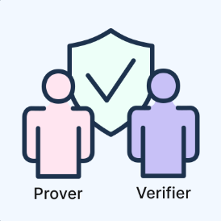
Zero Knowledge Proof
Steps:
3. The prover Alice returns the secret message to the verifier Bob

Slide 34
Homomorphic Encryption
Homomorphic Encryption (HE) is a type of encryption that allows computations to be performed on encrypted data, making itself computationally expensive.

Slide 35
Homomorphic Encryption
Homomorphic Encryption (HE) is a type of encryption that allows computations to be performed on encrypted data, making itself computationally expensive.
HE
encryption
computing
operation
HE
decryption
Encrypted
Texts
Encrypted
Computation Results
Decrypted Computation Results
Plaintext
same computing operation
Computation Results

Slide 36
Homomorphic Encryption
Fully HE (FHE) enables any computations to be performed on encrypted data, such as addition, subtraction, multiplication and division.
Partially HE (PHE) enables certain types of computations (not all) to be performed on encrypted data.

Slide 37
Homomorphic Encryption
Fully HE (FHE) enables any computations to be performed on encrypted data, such as addition, subtraction, multiplication and division.
e.g., BGV (Brakerski-Gentry-Vaikuntanathan)
Partially HE (PHE) enables certain types of computations (not all) to be performed on encrypted data. Specifically, PHE allows for either addition or multiplication operations.
e.g., RSA (homomorphic multiplication)
Paillier (homomorphic addition)

Slide 38
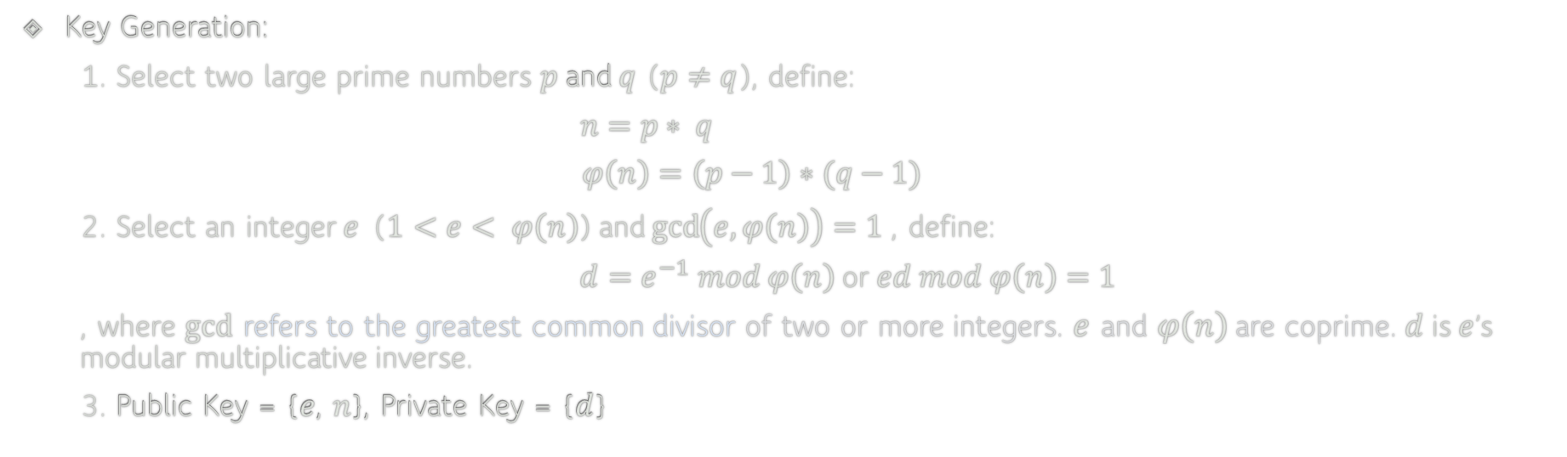
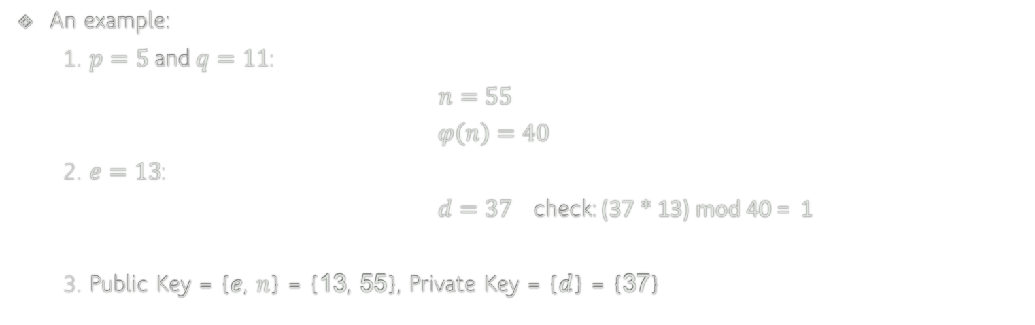
RSA
Key Generation:
1. Select two large prime numbers $p$ and $q$ ($p≠q$), define:
$n=p∗ q$
$$φ\left(n\right)=\left(p−1\right)∗(q−1)$$
2. Select an integer $e$ ($1<e< φ\left(n\right)$) and $\gcd\left(e, φ\left(n\right)\right)=1$ , define:
$d=e^{−1} mod φ\left(n\right)$ or $ed mod φ\left(n\right)=1$
, where $gcd$ refers to the greatest common divisor of two or more integers. $e$ and $φ\left(n\right)$are coprime. $d$ is $e$’s modular multiplicative inverse.
3. Public Key = {$e$, $n$}, Private Key = {$d$}
An example:
1. $p=5$ and $q=11$:
$n=55$
$$φ\left(n\right)=40$$
2. $e=13$:
$d=37$ check: (37 * 13) mod 40 = 1
3. Public Key = {$e$, $n$} = {13, 55}, Private Key = {$d$} = {37}

Slide 39









RSA: Secure Communication
Bob’s Public Key ($e$, $n$)
Bob’s Private key ($d$)
Plaintext m
Plaintext m
RSA encryption
$$c= m^{e} mod n$$
RSA decryption
$$m= c^{d} mod n$$
Alice
Cipher-text c
Bob

Slide 40
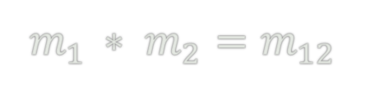

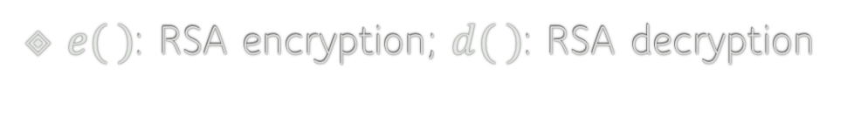
RSA: Homomorphic Multiplication
$e( )$: RSA encryption; $d( )$: RSA decryption
$$m_{1 }∗ m_{2}=m_{12}$$
$${e(m}_{1 })∗{e(m}_{2 })={e(m}_{1 }∗ m_{2})=e(m_{12})$$
Homomorphic Multiplication
$m_{12}={d(e\left(m_{12}\right))=d(e(m}_{1 }) ∗{e(m}_{2 }))=m_{1 }∗ m_{2}$

Slide 41
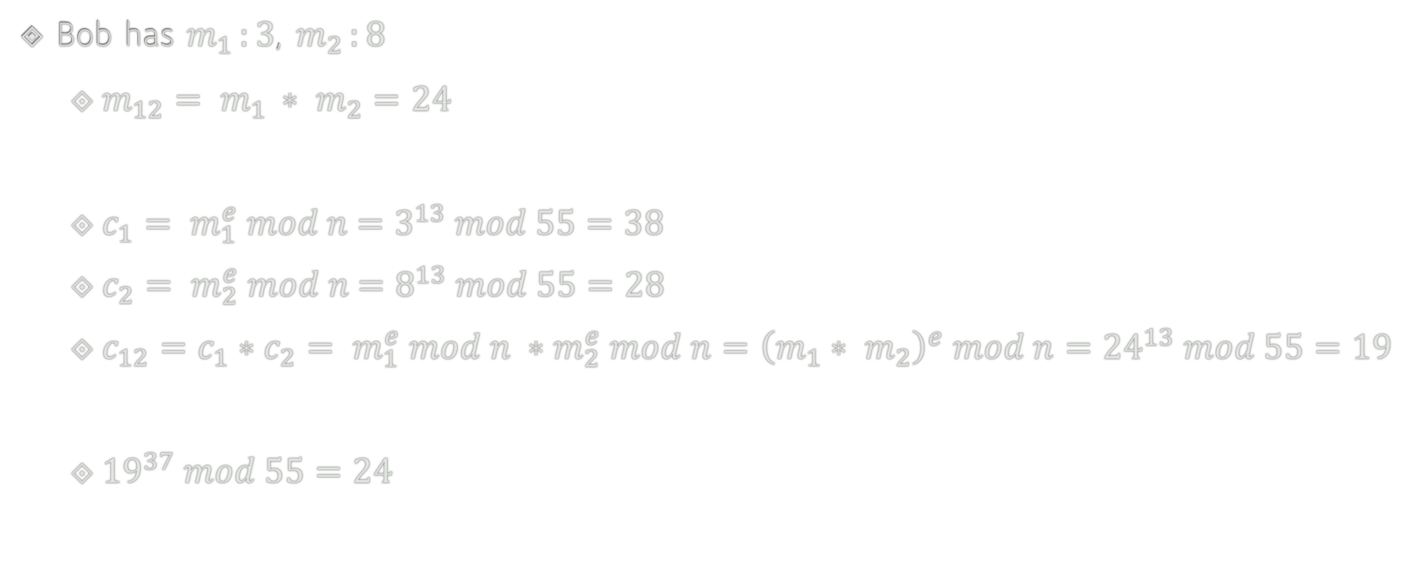


RSA: Homomorphic Multiplication
Bob has $m_{1 }:3$, $m_{2 }:8$
$m_{12}= m_{1 }∗ m_{2}=24$
$c_{1}= m_{1}^{e} mod n$ $=3^{13} mod 55=38$
$c_{2}= m_{2}^{e} mod n$ $=8^{13} mod 55=28$
$c_{12}=c_{1}∗c_{2}= m_{1}^{e} mod n ∗m_{2}^{e} mod n={\left(m_{1}∗ m_{2}\right)}^{e} mod n={24}^{13} mod 55=19$
${19}^{37} mod 55=24$
Public Key = {$e$, $n$} = {$13$, $55$}
Private Key = {$d$} = {$37$}

Slide 42
RSA: Homomorphic Multiplication
Bob has $m_{1 }:3$, $m_{2 }:8$
$m_{12}= m_{1 }∗ m_{2}=24$
$c_{1}= m_{1}^{e} mod n$ $=3^{13} mod 55=38$
$c_{2}= m_{2}^{e} mod n$ $=8^{13} mod 55=28$
$c_{12}=c_{1}∗c_{2}= m_{1}^{e} mod n ∗m_{2}^{e} mod n={\left(m_{1}∗ m_{2}\right)}^{e} mod n={24}^{13} mod 55=19$
${19}^{37} mod 55=24$
Public Key = {$e$, $n$} = {$13$, $55$}
Private Key = {$d$} = {$37$}

Slide 43
Differential Privacy
Differential privacy (DP) is also a concept in privacy that aims to provide strong guarantees for protecting the privacy of individuals in a dataset while allowing statistical analysis of the dataset.

Slide 44
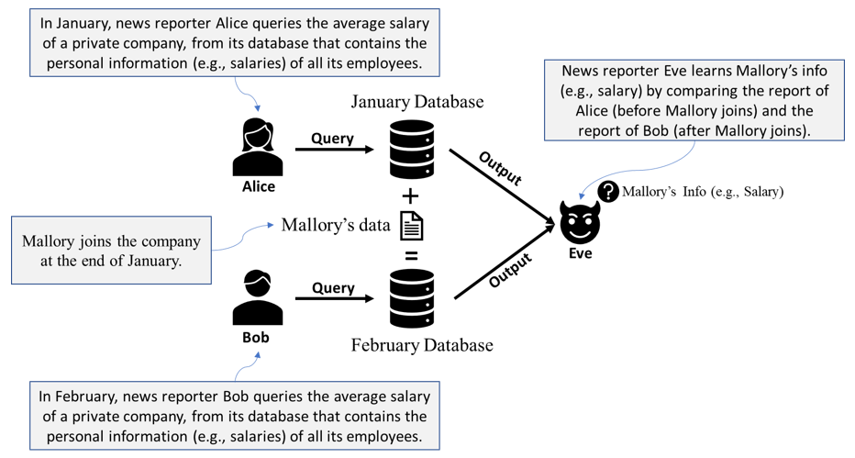
Differential Privacy

Slide 45
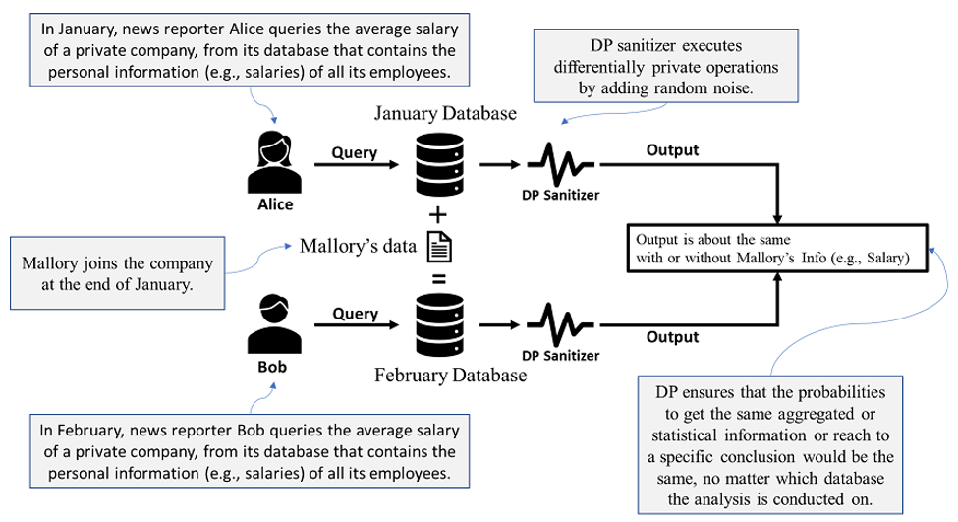
Differential Privacy

Slide 46
Differential Privacy
What is the main limitation of DP in practice?

Slide 47
Differential Privacy
What is the main limitation of DP in practice?
e.g., limited accuracy and high computational complexity.

Slide 48
Rowhammer
Rowhammer is a severe security vulnerability in dynamic random-access memory (DRAM), which can be induced by an unprivileged attacker.
DRAM Memory
Disk Storage

Slide 49
Rowhammer
Rowhammer is a severe security vulnerability in dynamic random-access memory (DRAM), which can be induced by an unprivileged attacker.
DRAM Memory
DRAM is volatile memory that stores data temporarily while the computer is running.
Disk Storage
Disk space refers to the amount of non-volatile storage space available on a disk drive.

Slide 50
Rowhammer
Rowhammer is a severe security vulnerability in dynamic random-access memory (DRAM), which can be induced by an unprivileged attacker.
Rowhammer can badly affect any devices that use DRAM, including but not limited to:
Personal computers such as Desktops and laptops.
Mobile devices such as smartphones and tablets.
Servers

Slide 51
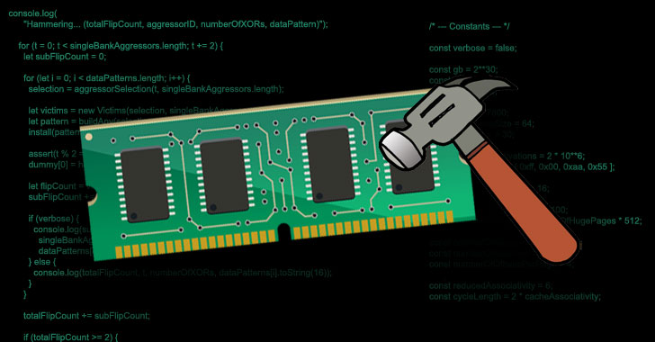
Rowhammer
DRAM rows
Frequently accessing
Rowhammer
https://thehackernews.com/2021/04/new-javascript-exploit-can-now-carry.html

Slide 52
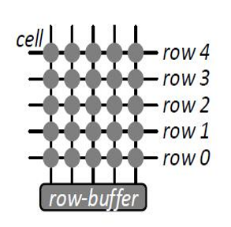
Structure of A DRAM Bank
Each cell is charged or discharged
A bank has rows of cells
Bank Layout
Diagram from Kim et al.

Slide 53
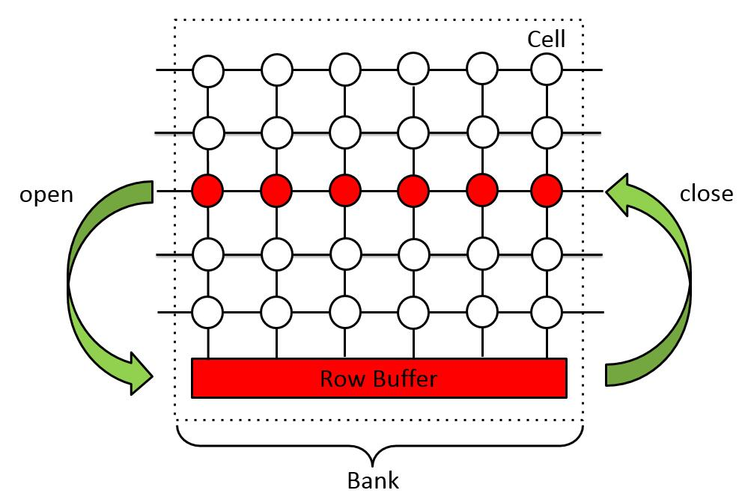
Memory access
Activating/opening a row
Accessing row buffer
Deactivating/closing the row

Slide 54
DRAM refresh
Cells can lose charge over time
A row of cells needs to be periodically charged/refreshed
The refresh interval is typically 64 ms

Slide 55
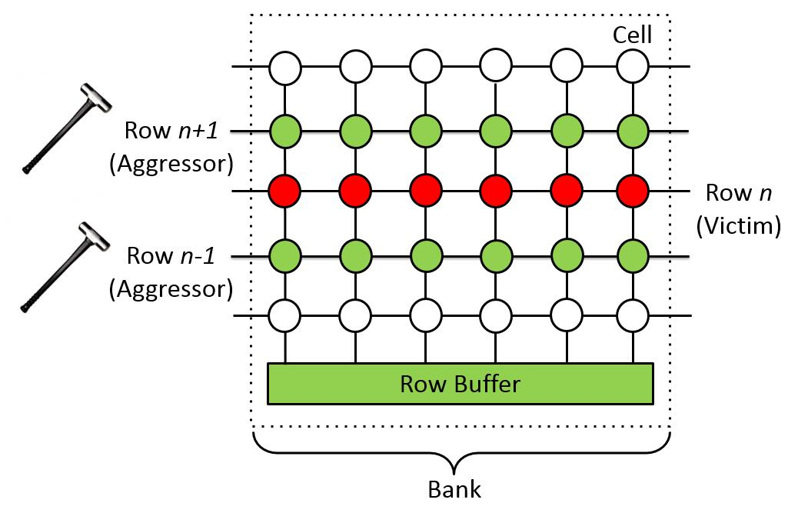
Rowhammer
Kim et al. key observation (ISCA’14)
Frequently opening rows n+1 & n-1 cause permanent charge leakage in row n. Permanent charge leakage means bit flips

Slide 56
Rowhammer
Double-sided hammer

Slide 57
Rowhammer code
Code from Kim et al.
1 loop:
2 mov (X), %eax
3 mov (Y), %ebx
4 clflush (X)
5 clflush (Y)
6 jmp loop
Flush/Evict CPU cache (e.g., clflush)
Clear row buffer (e.g., alternate access)

Slide 58
Rowhammer against Differential Privacy
Google implements DP as a software library
DP algorithm mathematically secure
(DP parameters are loaded into memory)
DP library
+noise
Rowhammer bit flip
Web server
Released DP output
True result
Database
an attacker
web application
DRAM memory

Slide 59
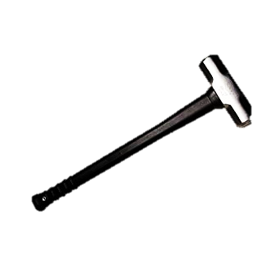
Rowhammer against Differential Privacy
cell
attacker process A
victim process B
attacker process A

Slide 60
Rowhammer against Differential Privacy
Database
True result
Released DP output
+noise
Rowhammer corrupts a key parameter
DP noise-generator
(Laplace mechanism)

Slide 61
Laplace-based Noise
DP output = true average + X, where X ~ Laplace(0, b)
0 is the centre of the noise, so positive and negative noise are both possible
negative noise
0
positive noise

Slide 62

Laplace-based Noise
DP output = true average + X, where X ~ Laplace(0, b)
0 is the centre of the noise, so positive and negative noise are both possible
b is the noise scale
Smaller b
Noise stays closer to 0
Less spread-out noise
Weaker privacy
Usually better accuracy
e.g., b = 1
noise values:
-0.4, 0.2, 0.8, -1.1

Slide 63

Laplace-based Noise
DP output = true average + X, where X ~ Laplace(0, b)
0 is the centre of the noise, so positive and negative noise are both possible
b is the noise scale
Smaller b
Larger b
Noise stays closer to 0
Less spread-out noise
Weaker privacy
Usually better accuracy
Noise can be farther from 0
More spread-out noise
Stronger privacy
Usually lower accuracy
e.g., b = 1
e.g., b = 4
noise values:
-0.4, 0.2, 0.8, -1.1
noise values:
-3.8, -1.3, 2.1, 5.6

Slide 64
Laplace-based Noise
DP output = true average + X, where X ~ Laplace(0, b)
0 is the centre of the noise, so positive and negative noise are both possible
b is the noise scale, so larger b means the noise is more spread out
b = Δ / ε: larger ε ⇒ smaller b

Slide 65
Laplace-based Noise
Bounded monthly salaries
$0 to $20,000
100 employees
before Mallory joins
Average sensitivity
Δ = 20,000 / 100 = $200
In normal DP
ε = 1 ⇒ b = $200
Sample noise: +$120 or −$80
In Rowhammer-faulted DP
ε' = 8 ⇒ b' = $25
Sample noise: +$12 or −$8

Slide 66
Laplace-based Noise
Normal DP: b = $200
Rowhammer-faulted DP: b' = $25
January true: $8,000 Sampled noise: +$120 DP output: $8,120 February true: $8,040 Sampled noise: −$80 DP output: $7,960
January true: $8,000 Sampled noise: +$12 Faulted output: $8,012 February true: $8,040 Sampled noise: −$8 Faulted output: $8,032
Inference: 101×7,960 − 100×8,120 = −$8,040
Inference: 101×8,032 − 100×8,012 = $10,032
Inference fails
Inference becomes useful

Slide 67
Rowhammer against Differential Privacy
Find a key parameter
Induce a single-bit flip
Perform a stronger inference

